Slide 1
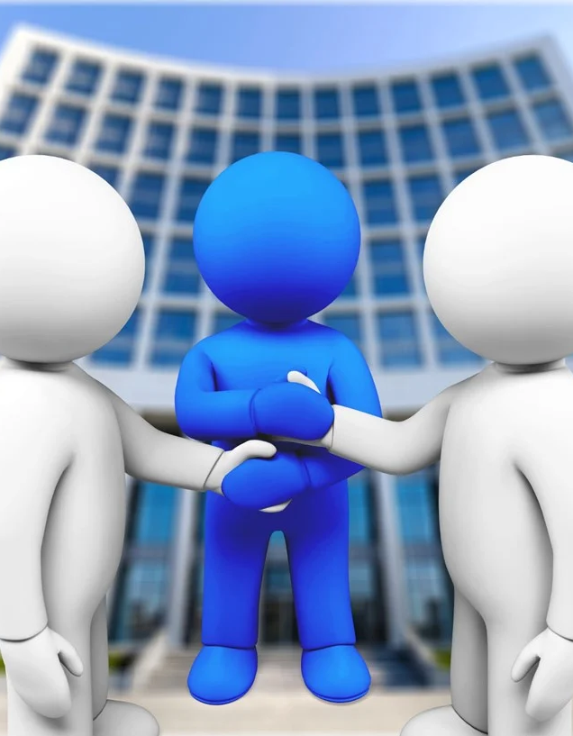
DEBIT DAWN
The Middle Man You Need

Slide 2
Agenda
1
2
3
4
5
Introduction
Literature survey
Requirements
description
System analysis and design
Results and output

Slide 3
Introduction
Problem statement:-
Trust is a key element that mediates the interaction between humans and non-human agents. Now a days distance and trust barrier are the main primary cause of many people and they are very much relying upon trusted and authorized sites and sellers but they are getting scammed anyway. The current peer to peer system has many flaws which results in a number of foreseen outcomes like fraudulent activities which creates a distrust between people .

Slide 4
Project Overview
Debit Dawn-The middleman you need, is a website that solely aims to bring together buyers and sellers from different cities and make transactions safe and trust worthy. This site will target the distance and trust barrier which are the primary causes of many buyers and sellers.
The buyer can surf apps like OLX , Quikr to look for suitable products and then inform the seller about making a purchase through debit dawn.
The site works on traditional escrow system where buyer transacts money to the site which will be on hold until the transaction with the seller is completed.
If the buyer is not satisfied with the product received then the buyer needs to raise a complain and the payment will result in halt or unsuccessful until the complaint is solved and also there should be proper evidences (in terms of video evidence which is needed to be shared with us), in case of any complain raised from either side.
As per commission, the buyer will charged with a small processing fee which is not at all refundable even if the transaction between buyer or seller fails.

Slide 5
Specifications
Hardware
Software
Processor : AMD Ryzen 1700X(8 cores,16 threads)
RAM : 8 Gb or Higher
Disk Space: 10 GB
GPU : Nvidia RTX 2060
My PHP
Apache
XAMPP
WordPress
Host- Infinity Free

Slide 6
Literature survey
Existing system:-
Peer-to-peer(P2P) buying system is a decentralized model where either person with a need of some product or service can approach the other person via different modes of communication and initiate the transaction.
Peer-to-peer system has the biggest flaw that is trust factor. Each of the person has to be in each other’s vicinity to initiate the transactions else either person can cheat either one.

Slide 7
Proposed System:-
Middle Man, is a broker, go between or intermediary to a process of transaction. An intermediary will earn a fee or commission in return for services rendered in matching buyers and sellers. Many industries and business sectors utilize middlemen, from trade and commerce to wholesalers to stockbrokers. This will increase the feasibility and accountability of transaction more viable.

Slide 8
Feasibility System:-
Escrow System, is a legal arrangement in which a third party temporarily holds money or until a particular condition has been met. Digital Escrow System, is the answer to the recurring problem of monetary fraud in the form of money laundering and security breaches. Here, an unbiased third party in the form of digital escrow accounts safely parks your money and facilitates the transactions between two parties

Slide 9
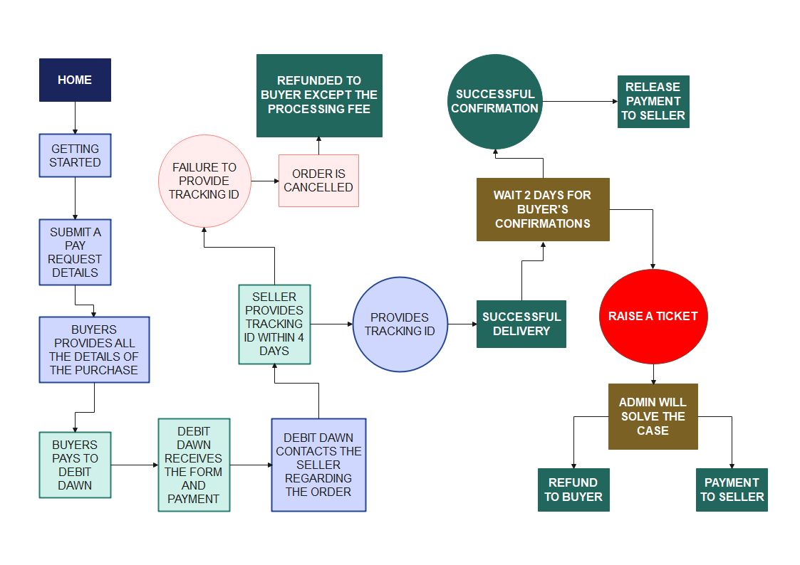
Class Diagram

Slide 10
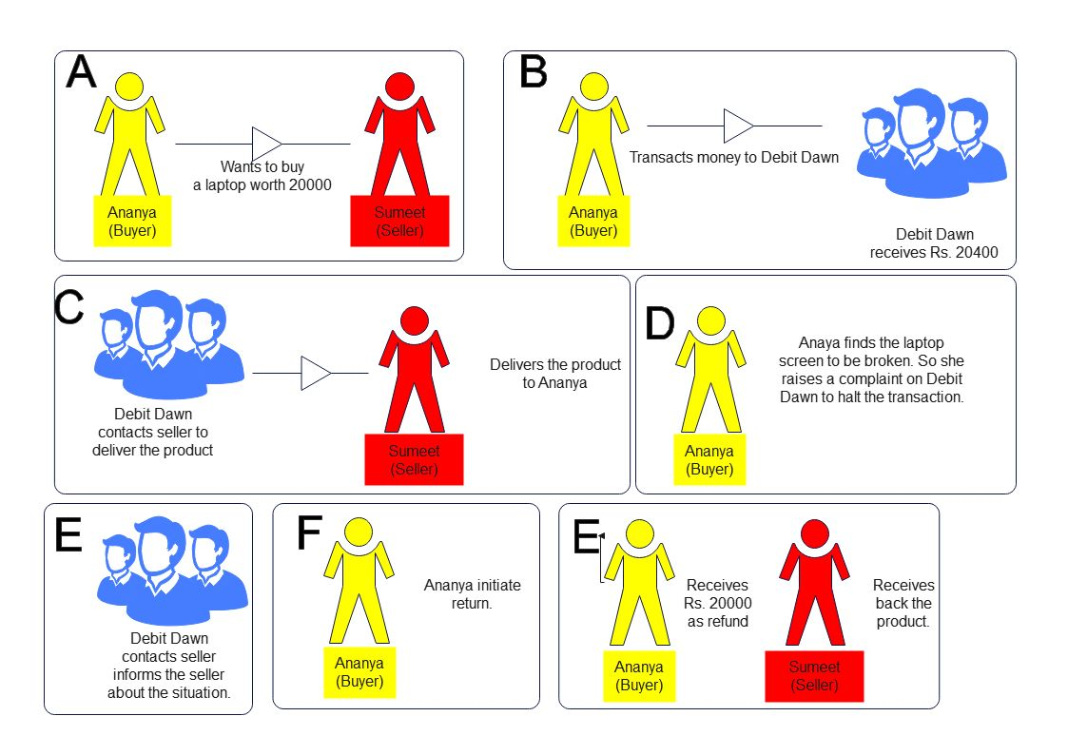
Sequence diagram

Slide 11
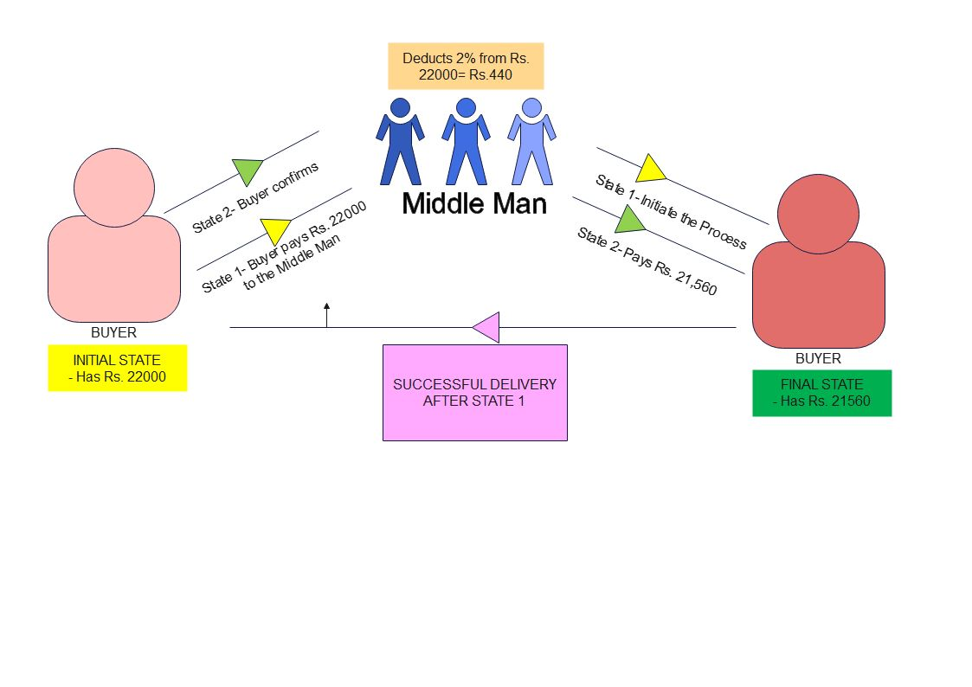
State chart Diagram

Slide 12
Conclusion
Uniqueness:-
We have created a website that works digitally on the principles of escrow system. This website aims to make P2P(peer-to-peer) transactions more viable and trustworthy. We made sure that the transactions and details of this system remain confidential. We were also able to achieve maximum potential with ecommerce . As a middleman operating this process of transaction, a 2% of processing fee will be charged to the first party which is not refundable even if the transaction between the buyer and seller is terminated.

Slide 13
Limitation:-
The major drawbacks of the middle man system is reputation and flood of competitions. Reputation is a key factor in this business. So one bad review can ruin the whole system. Likewise, flood of competitions like other companies following the same business might create a havoc between people and will also trigger distrust amongst them.
Future Scope:- Debit Dawn has a major potential in the P2P market where people mostly hesitate to search beyond their own locality. We will completely disband the factor of distance and let people search freely and fearlessly within our country. With right mindset and approach to this market, Debit Dawn will put an end to thieves and fraudsters from running their businesses as there is no way for them to cheat.

Slide 14
Thank you

